Slide 1
Dynamic Testing
Er. Bipin Thapa

Slide 2
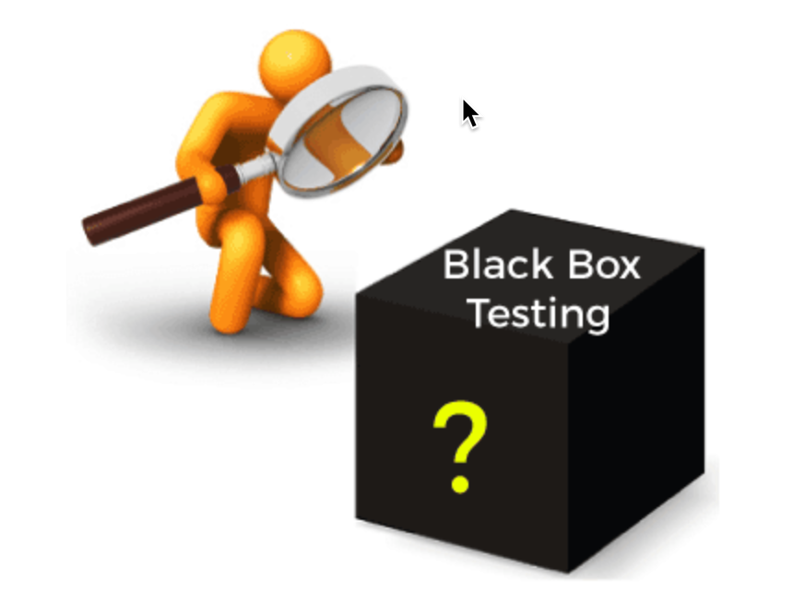
Black Box Testing
Black Box is a software testing method in which the internal structure/design/implementation of the item being tested is not known to the tester.
Only the external design and structure are tested.
It is a software testing technique that examines the functionality of the software without knowing its internal structure or coding.
It does not require programming knowledge of the software.
Boundary Value Analysis
Equivalence Class Partitioning
Decision Table Testing
State Transition Testing

Slide 3
Black Box Testing
Some of the popular techniques involved in Black-box testing are
Boundary Value Analysis
Equivalence Class Partitioning
Decision Table Testing
State Transition Testing

Slide 4
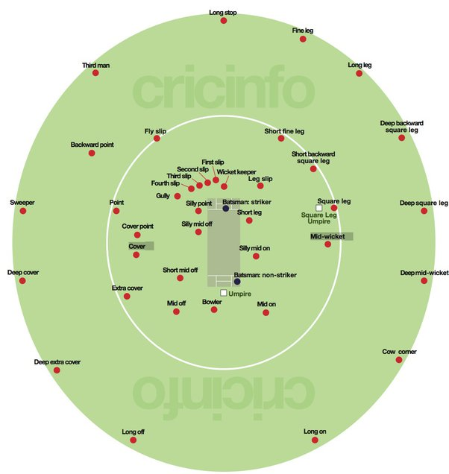
Boundary Value Analysis
Boundary testing is the process of testing between extreme ends or boundaries between partitions of the input values.
We mainly test the following values
Minimum
Just above the minimum
Just below the maximum
Maximum

Slide 5
Boundary Value Analysis
Q1: Assume we have to test a field that accepts age between 20 to 30
Valid = min, min+1
Valid = max, max-1
Invalid = min-1 and max+1
Q2: Assume we have to test a field which accept mobile no. of 10 digits.
Invalid. <10 digits
Valid. == 10 digits
Invalid > 10 digits

Slide 6
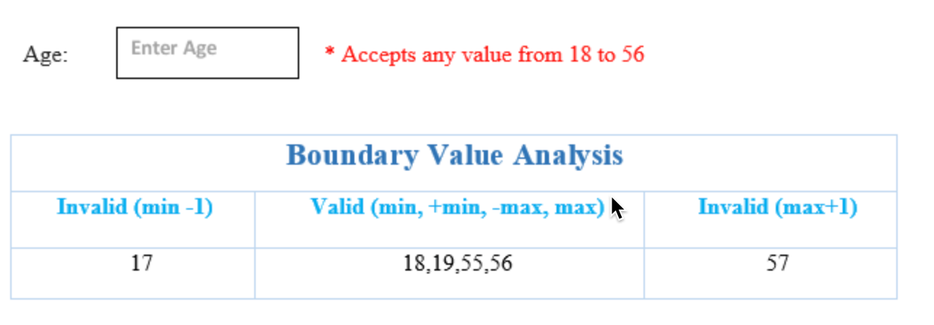

Slide 8
Equivalence Class Partitioning
It is a test Design techniques which divide input test data into partitions.

Slide 9
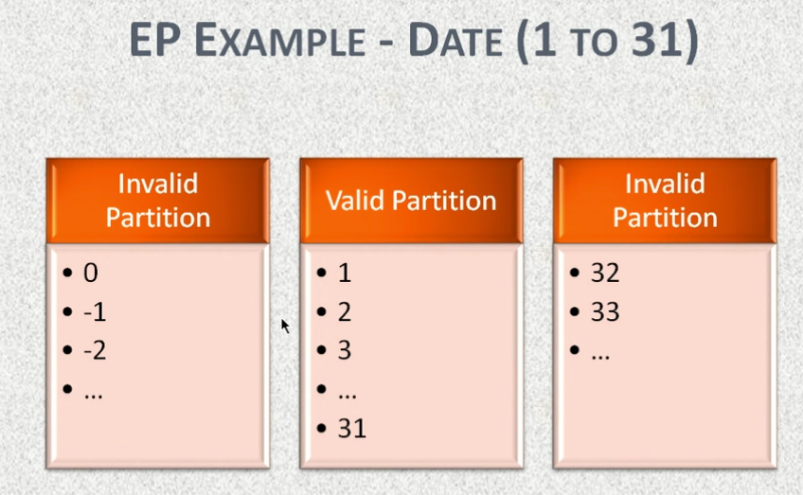
Equivalence Class Partitioning

Slide 10
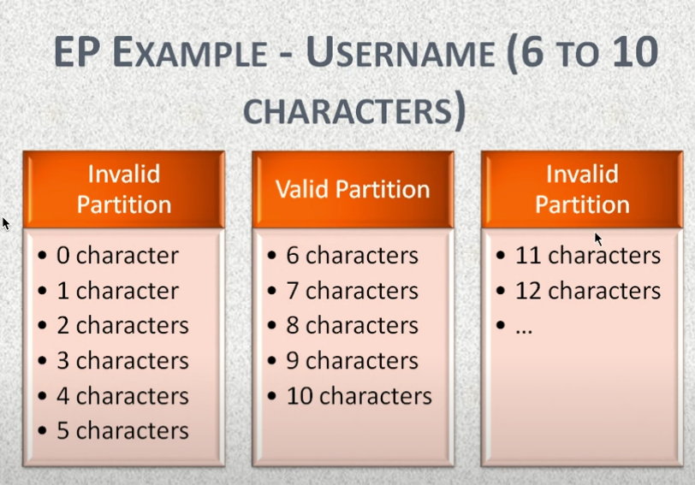

Slide 11
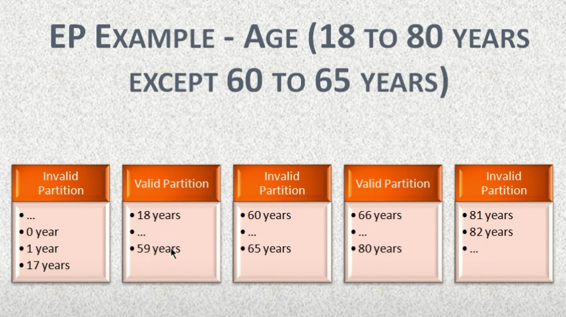

Slide 13

Decision Table Testing
It is a good way to deal with a combination of inputs, which produce different results.
It reduce test effort in verifying every combination of test data, at the same time ensuring complete coverage.

Slide 14
Decision Table Testing
Example:
let's consider the behavior of Sign-In Button for different combinations of Username & Password.
(i.e Invalid and valid combination for both username and password)

Slide 15
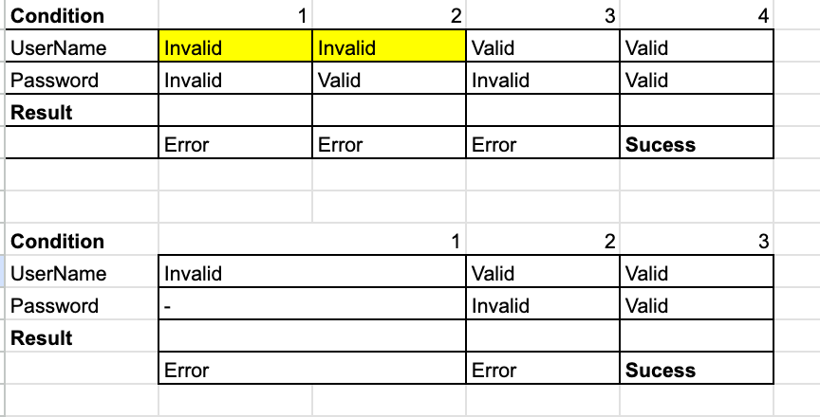

Slide 16
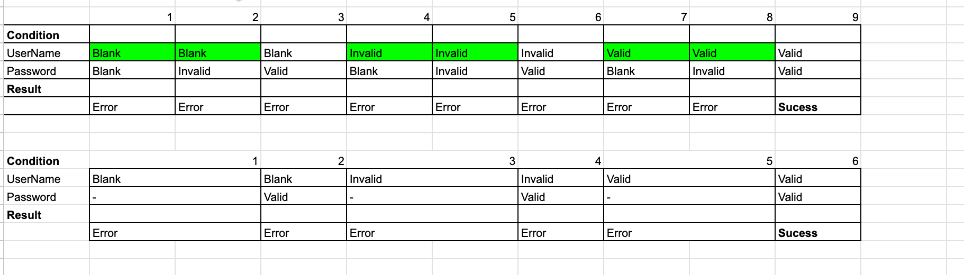

Slide 17
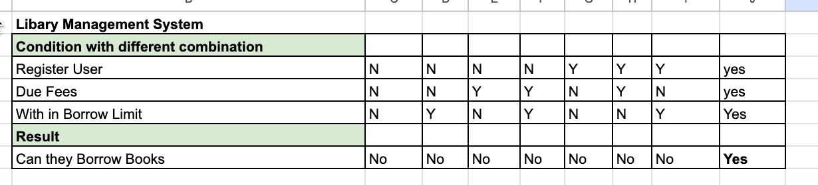

Slide 18
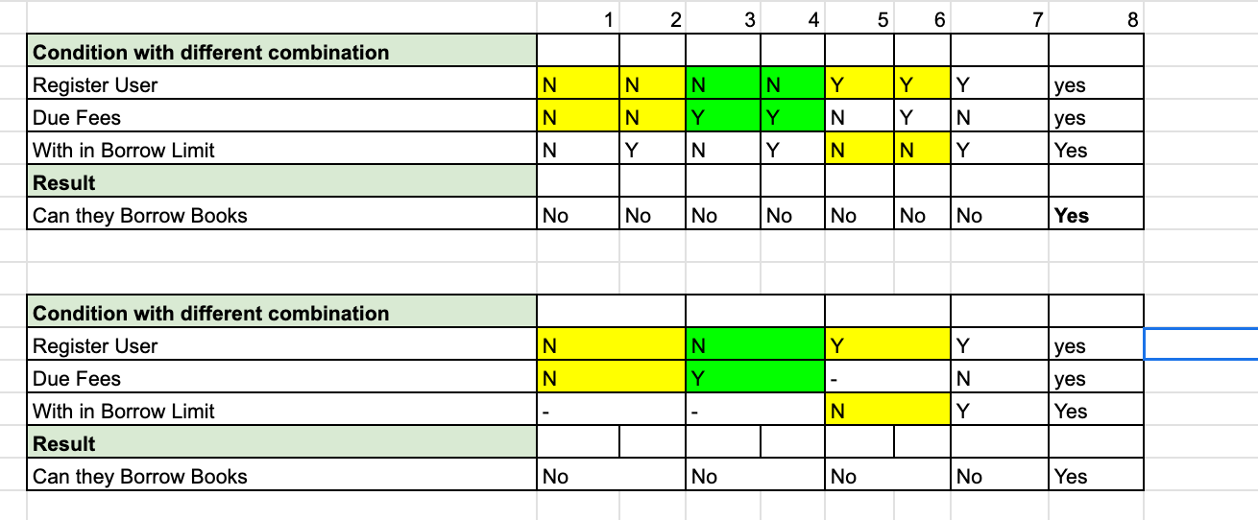

Slide 19
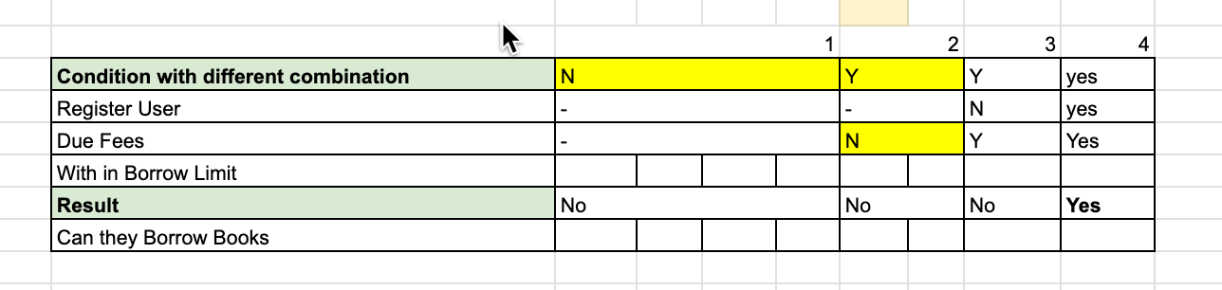

Slide 20
State Transition Testing
Using state transition testing, we pick test cases from an application where we need to test different system Transitions.
We can apply this when an application gives a different output for the same input, depending on what has happened in the earlier state.

Slide 21

State Transition Testing
Example 2:
You visit an ATM and withdraw $1000. You get your cash. Now you run out of balance and
make the same request of withdrawing $1000. This time ATM refuses to give you the money
because of insufficient balance. So here the transition, which caused the change in
state is the earlier withdrawal.

Slide 22
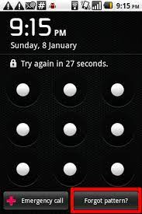
State Transition Testing
Example 1: Login page of an application which locks the user name after three wrong attempts of password for few min.
Again if incorrect password are provided then it will locked for few hrs.
And if again incorrect password are provided then it will locked for 24 hrs.

Slide 23
